Slide 2
Campus Connect
Submitted to:
Department of Computer Science and Engineering

Slide 3
Supervised by: Prof. Sushma Khatri
Team Members
1.Mann Gupta
2.Piyush Mallick
3.Mahi Patel

Slide 4
Project Presentation Outline
Problem Statement
Introduction
Survey of Existing Systems
Project Objectives
Requirement Analysis
Solution Proposed
Features
System architecture
User Interface
Testing Plan
The Outcome Discussion
Conclusions

Slide 5
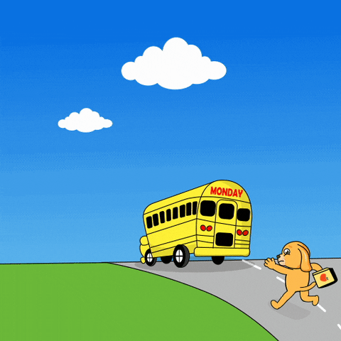
The Problem Statement
Do you also run for your bus like this 🤨 ?

Slide 6
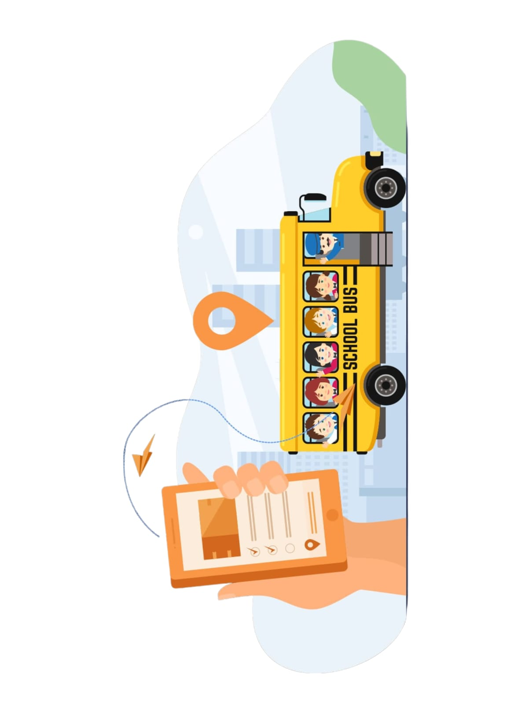
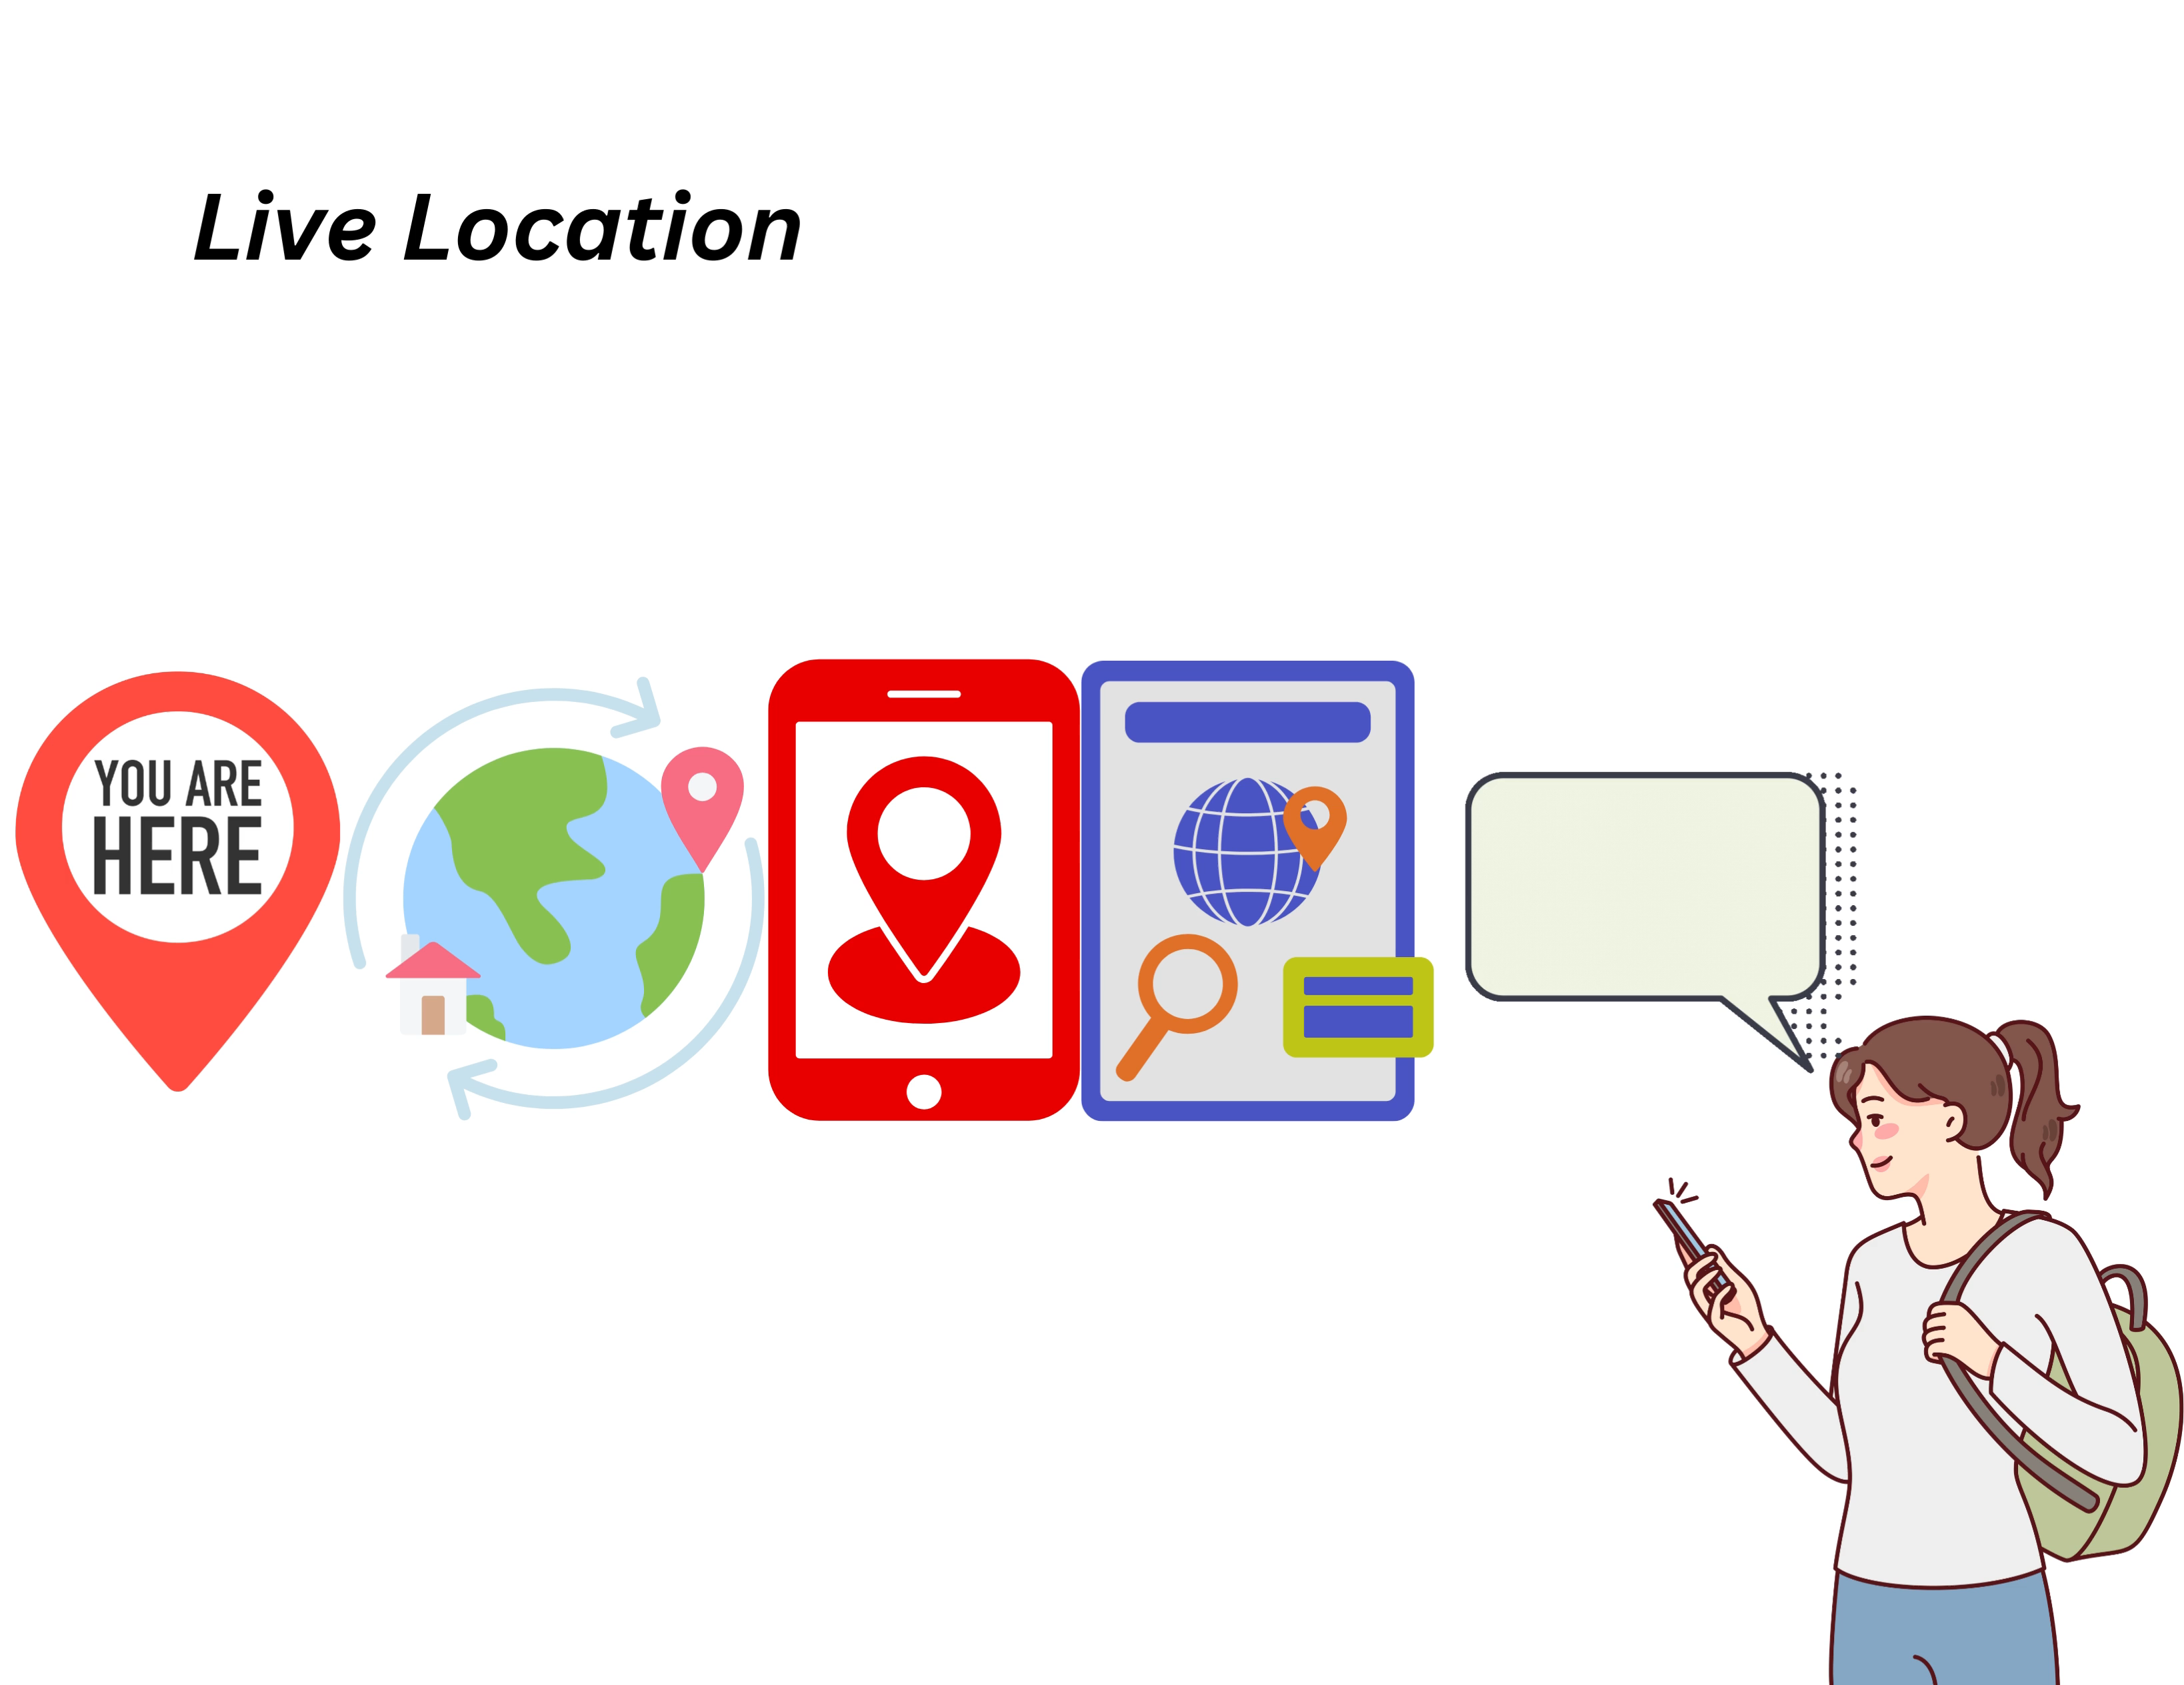
Introduction
"Campus Connect" – a groundbreaking initiative poised to redefine transportation within our campus community.

Slide 7
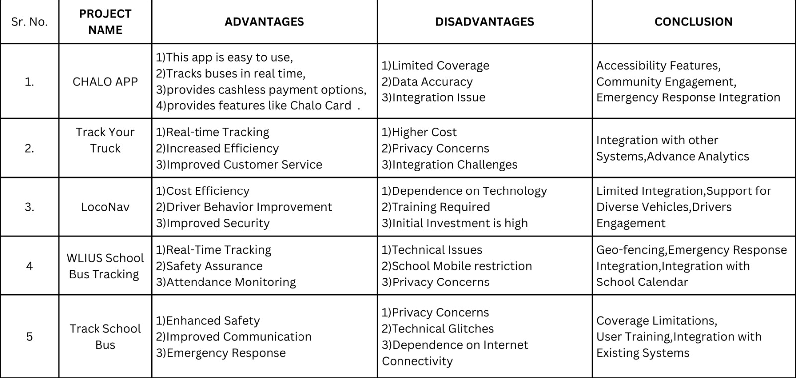
Survey of Existing Systems

Slide 8


Objectives
To implement Real Time Bus Tracking.
To Develop user friend mobile app
To Create notification System
To implement Additional features like:-
Merge Routes
Feedback System
Device Compatibility

Slide 9

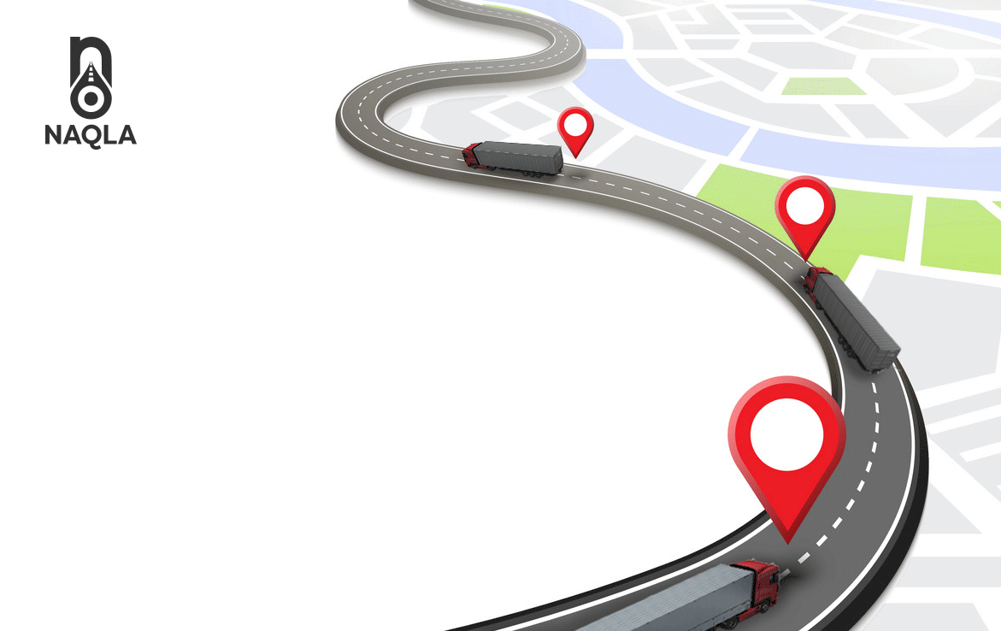
Requirement Analysis
Functional Requirements:-
Real Time Bus Tracking System
Notification System
Feedback system
Mobile app
Non-Functional Requirement:-s:-
Scalability
Compatibility
Maintainability

Slide 10
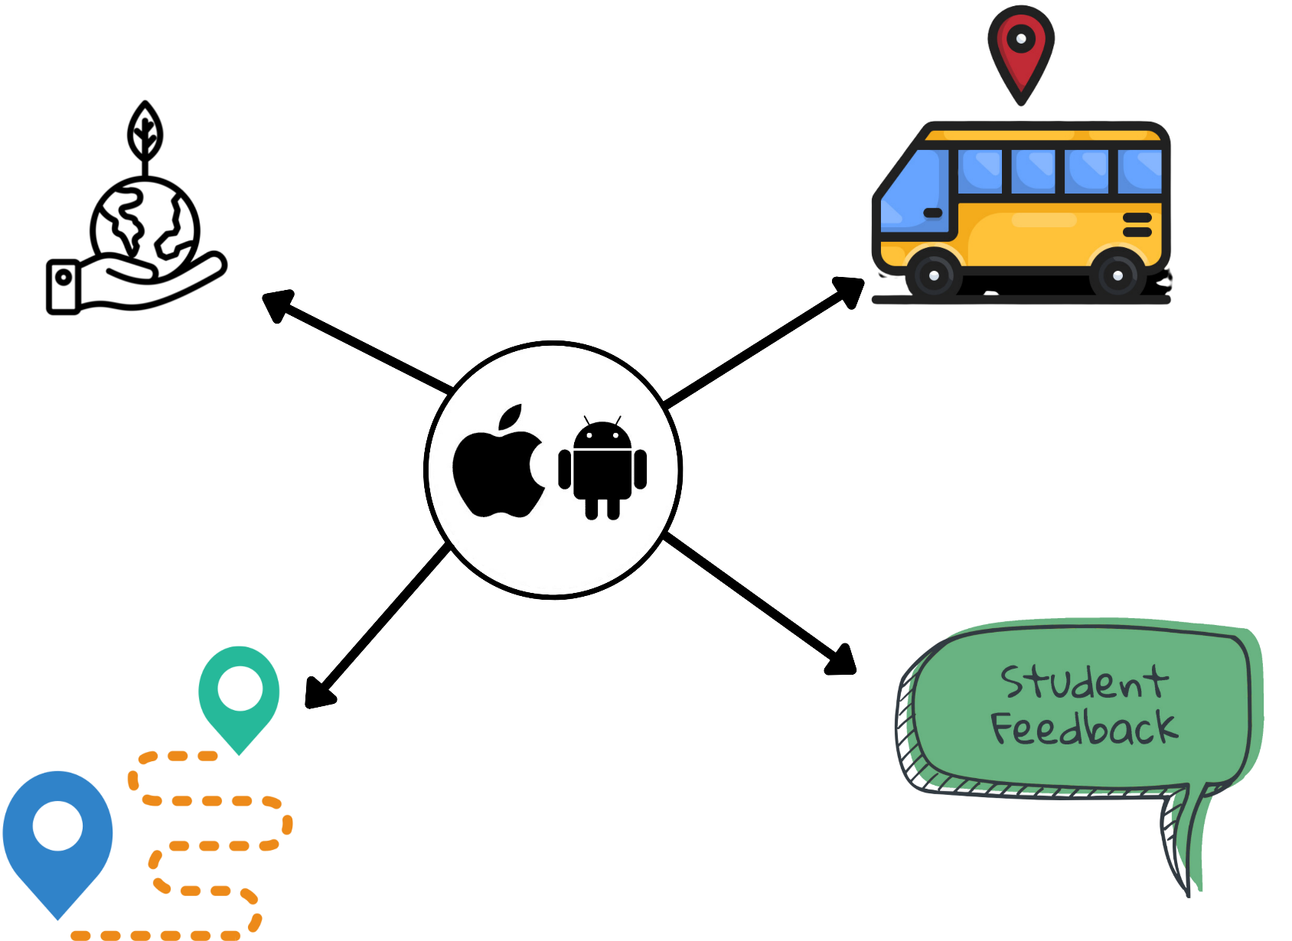
Solution Proposed

Slide 11
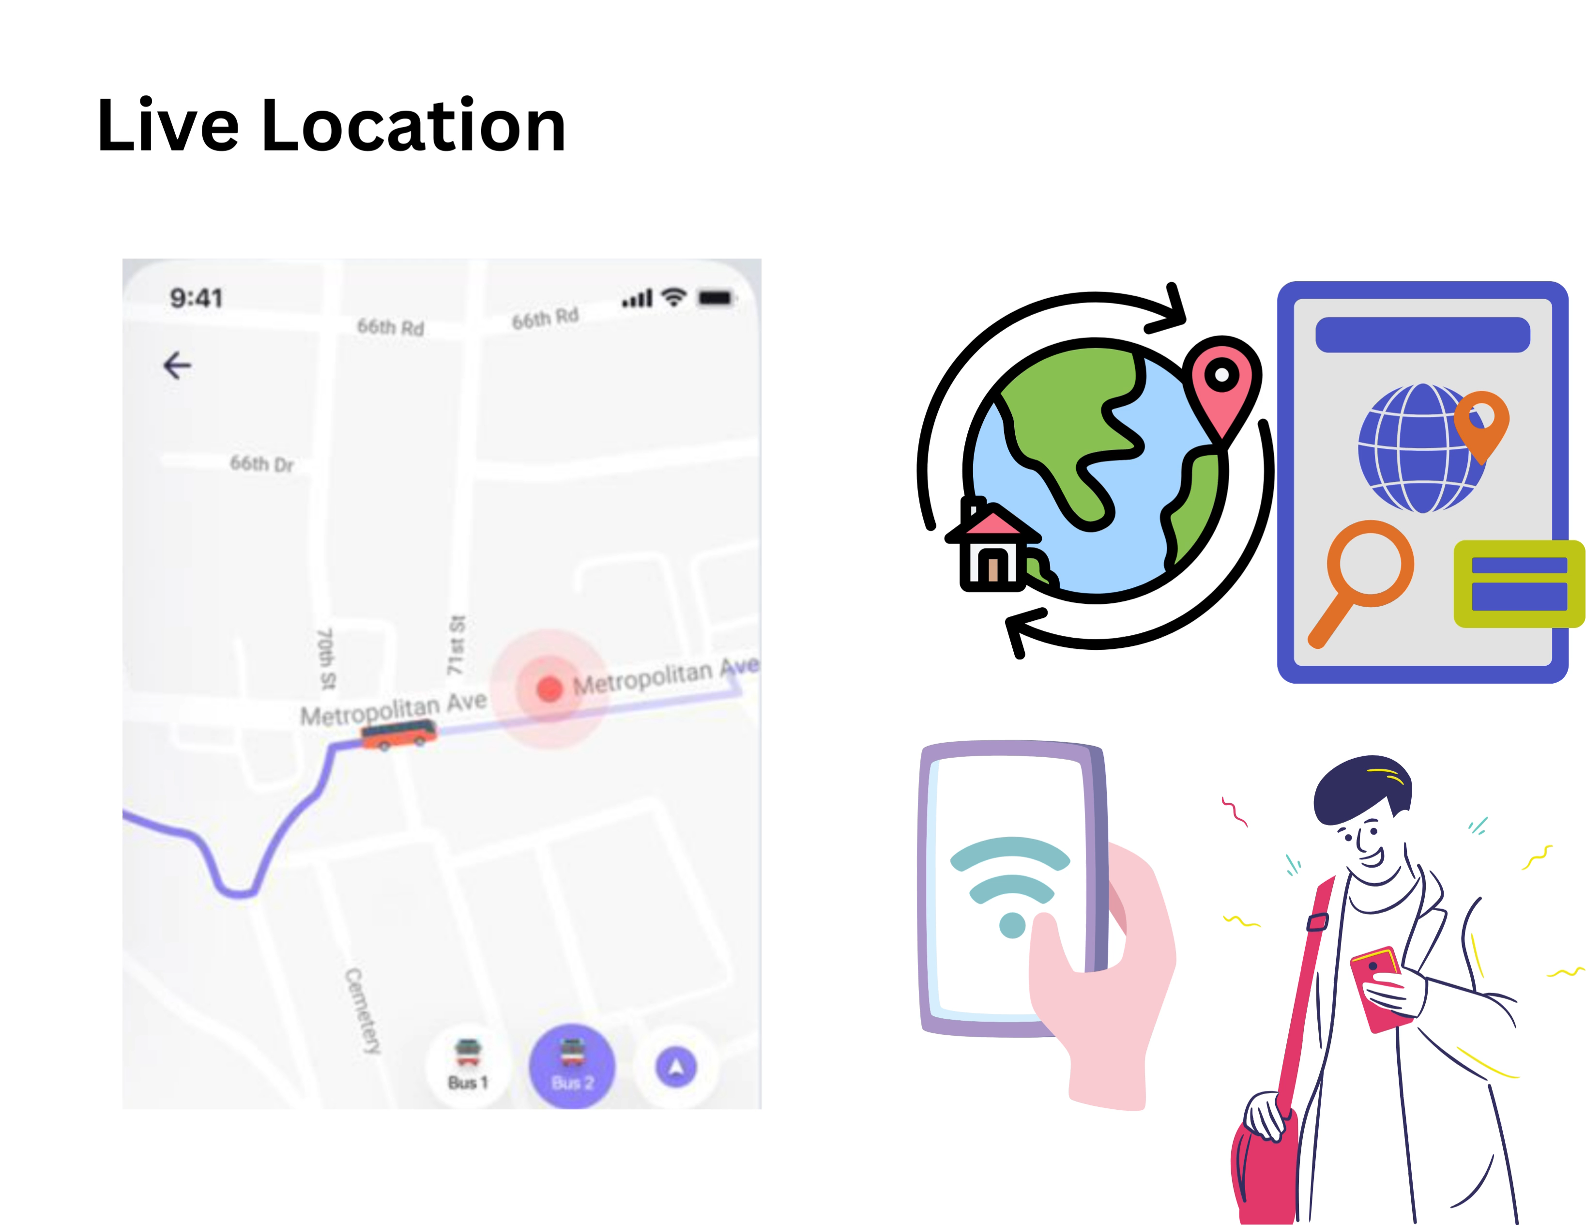
Features

Slide 12
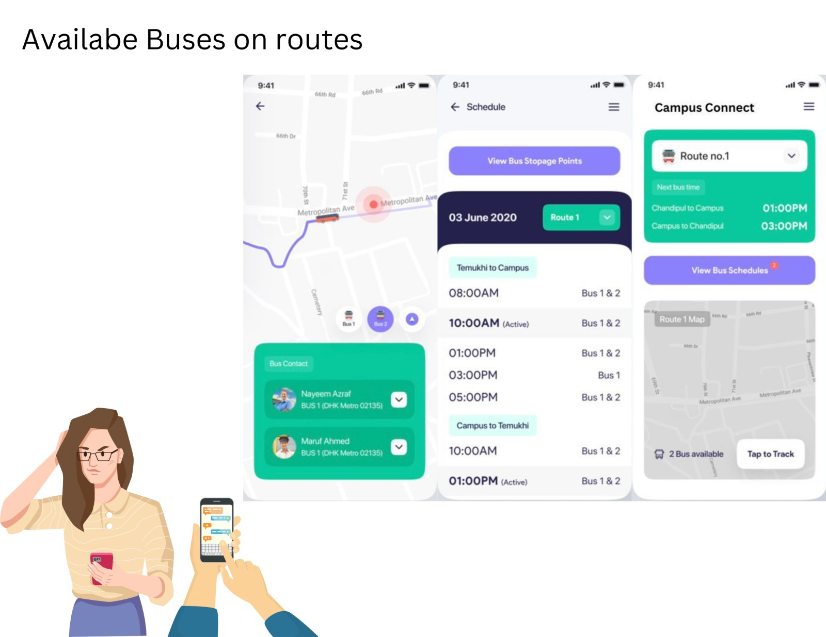
Features

Slide 13
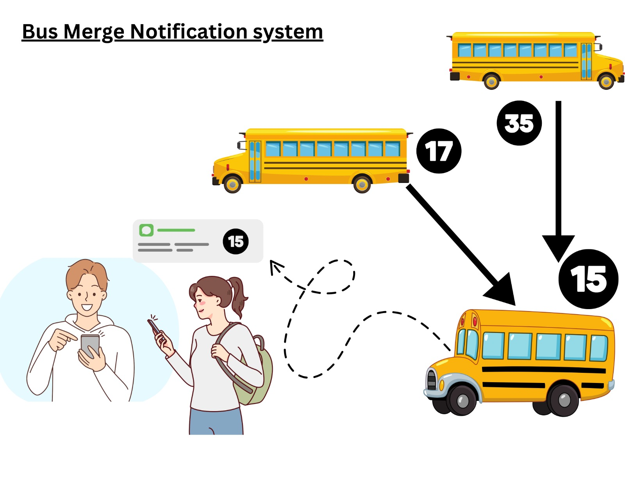
Features

Slide 14
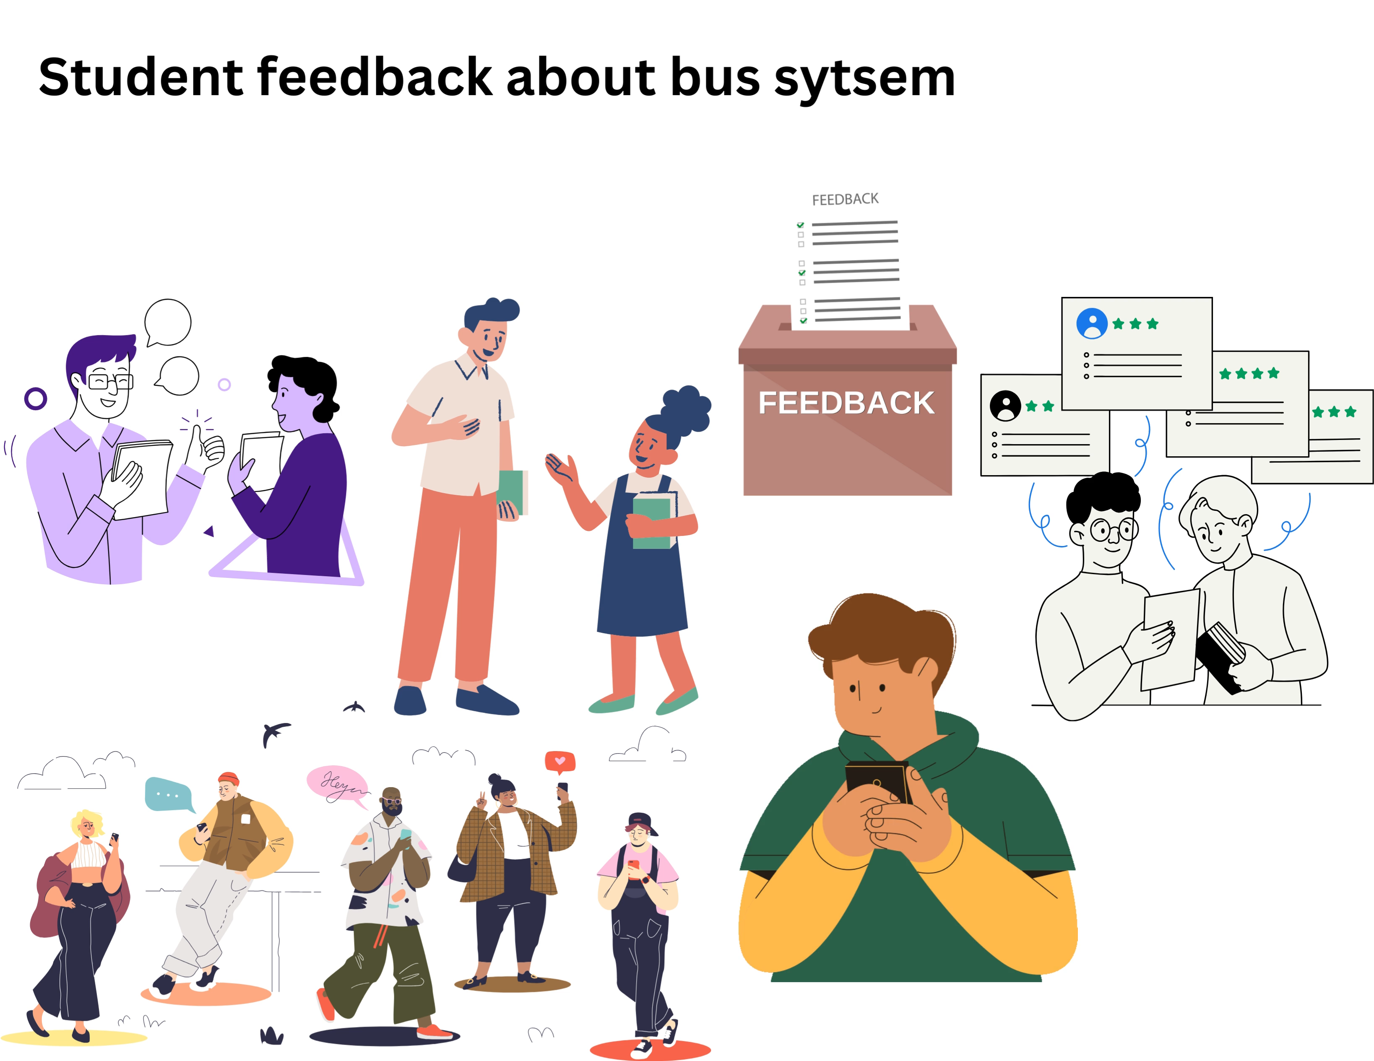
Features
system

Slide 15
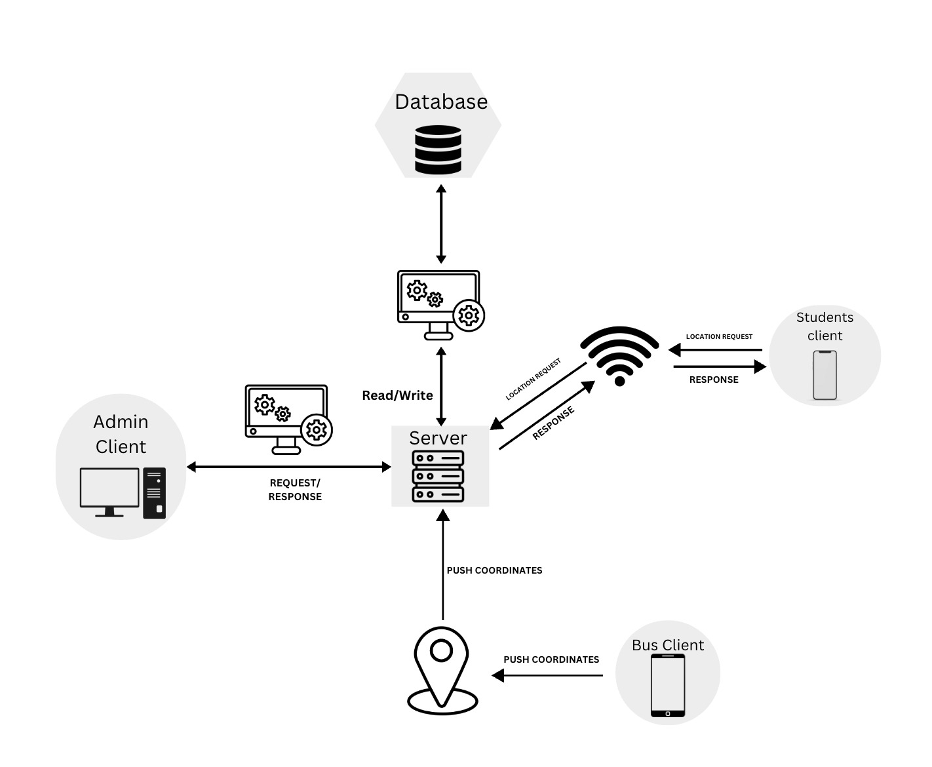
System Architecture

Slide 16
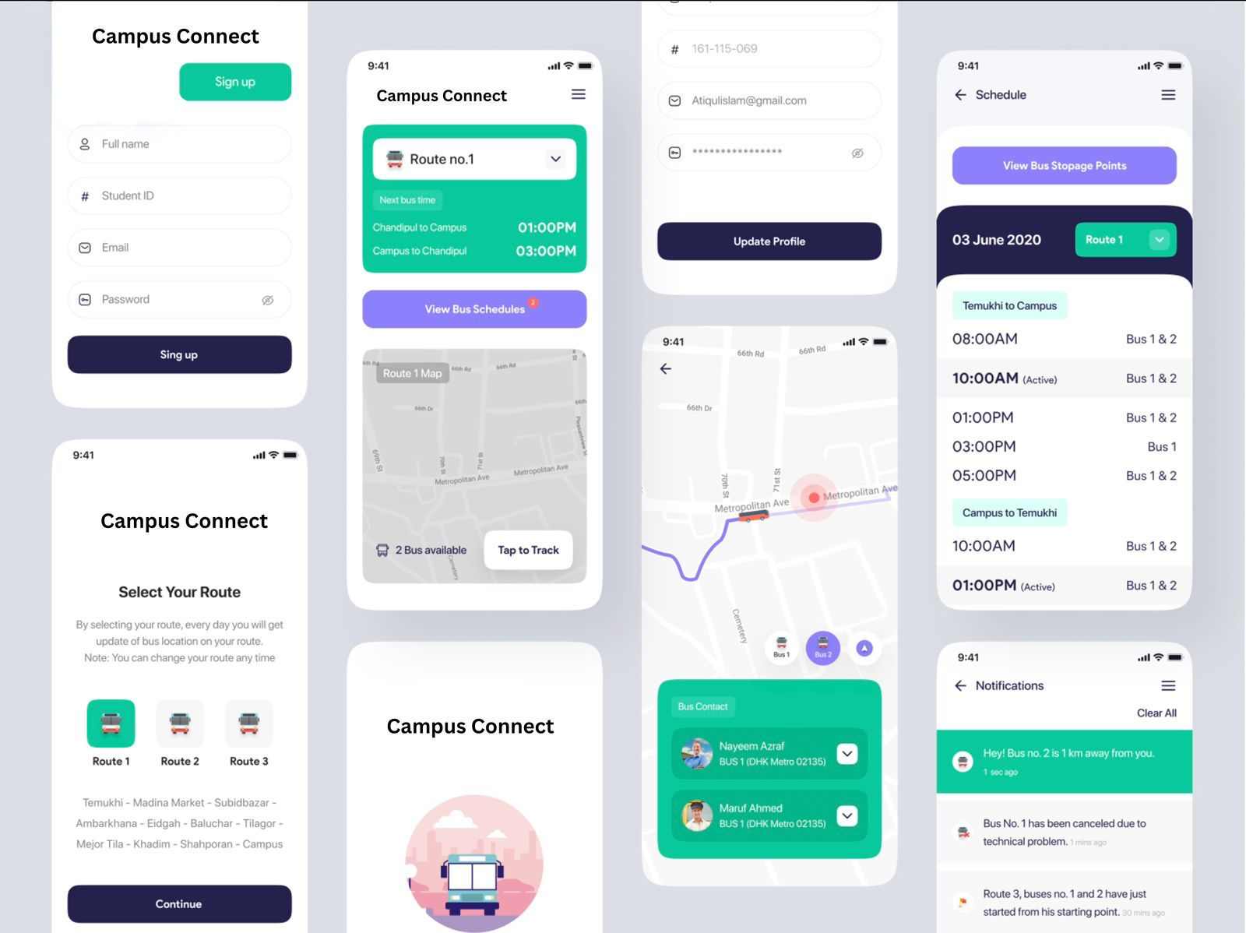
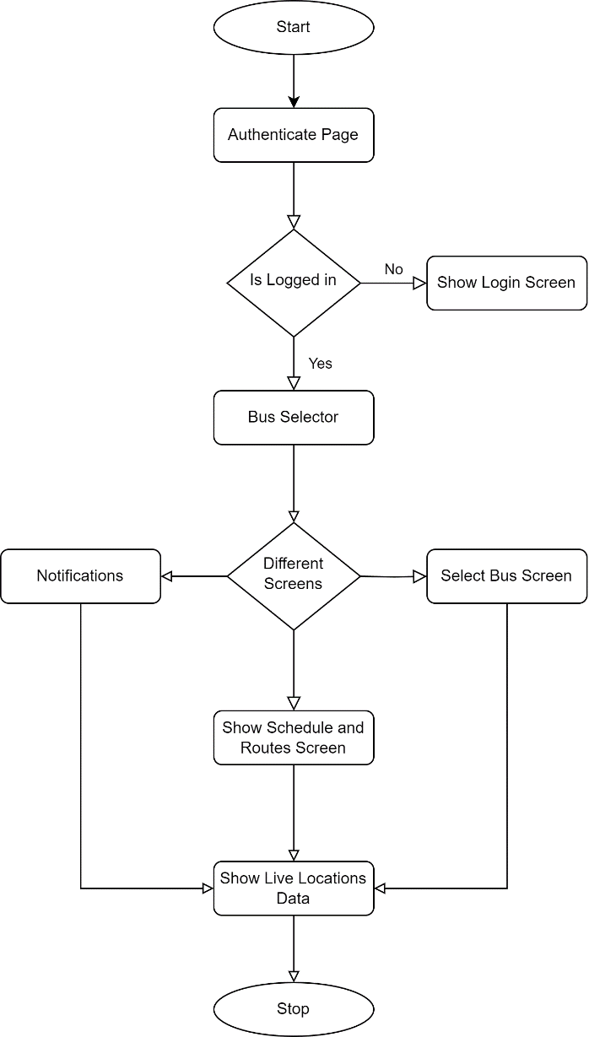
User Interface

Slide 17
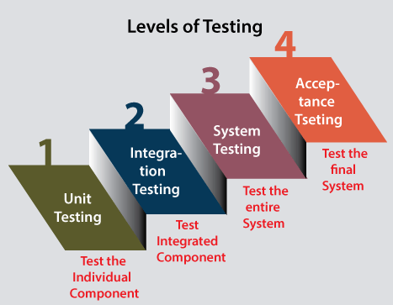
Testing Plans

Slide 18
Testing Plans
Unit Testing:
• User authentication module
• Live bus tracking algorithm
• Notification system logic
• Route information integration
b. Integration Testing:
User registration and login with live tracking feature
Mobile application integration with notification system
Route information integration with live bus tracking
c. User Acceptance Testing (UAT)
Users can register and log in successfully.
Users can view live bus locations accurately.
Users receive timely notifications for bus arrivals, delays, and route changes.
Users can access comprehensive route information

Slide 19
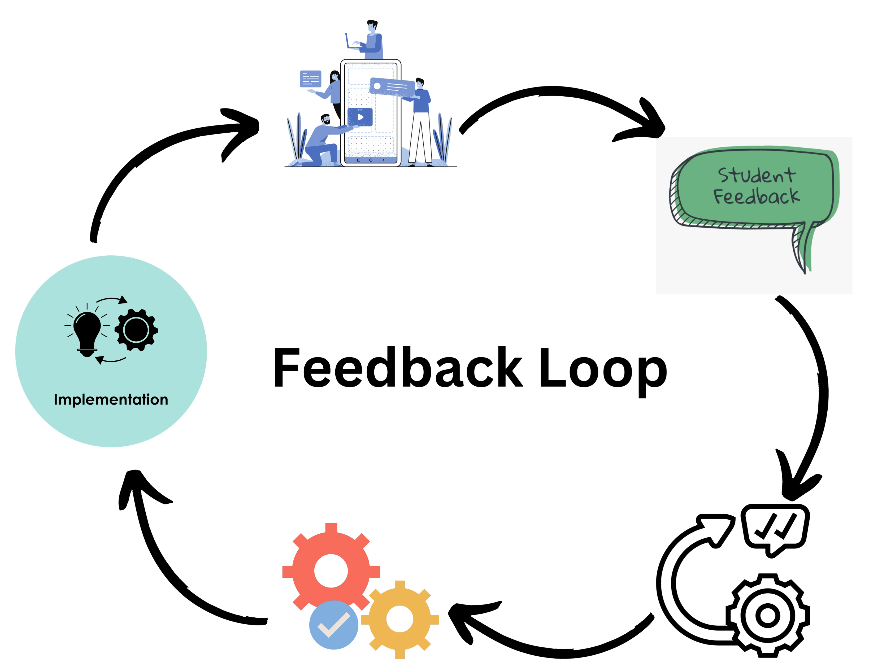
The Outcome
Improved Transportation Efficiency
Enhanced User Experience
Increased Reliability and Convenience
Increase Sustainability
Feedback Loop
Inclusive Interface

Slide 20
Conclusion
Achieving Transportation Excellence
Meeting Diverse Needs
Benefits for the Campus Community:-
Improved Efficiency
Enhanced User Experience
Continuous Improvement

Slide 21
Acknowledgment
We extend sincere thanks to the dedicated team members and contributors for their invaluable efforts in developing the Bus Tracking System. Special appreciation to Prof. Sushma Khatri for their exceptional expertise. Gratitude also goes to our stakeholders for their continuous support throughout this project. Your contributions were pivotal.

Slide 22
Q&A

Slide 23
THANKS

